Slide 1
Application Layer
Computer Communications and Networks
ITCS 6166/8166
Dr. Dewan Tanvir Ahmed
Department of Computer Science
University of North Carolina at Charlotte

Slide 2


Chapter 2 Application Layer
Computer Networking: A Top Down Approach 6th edition Jim Kurose, Keith Ross Addison-Wesley March 2012
A note on the use of these ppt slides:
We’re making these slides freely available to all (faculty, students, readers). They’re in PowerPoint form so you see the animations; and can add, modify, and delete slides (including this one) and slide content to suit your needs. They obviously represent a lot of work on our part. In return for use, we only ask the following:
If you use these slides (e.g., in a class) that you mention their source (after all, we’d like people to use our book!)
If you post any slides on a www site, that you note that they are adapted from (or perhaps identical to) our slides, and note our copyright of this material.
Thanks and enjoy! JFK/KWR
All material copyright 1996-2012
J.F Kurose and K.W. Ross, All Rights Reserved

Slide 3
Chapter 2: outline
2.1 Principles of network applications
2.2 Web and HTTP
2.3 FTP
2.4 Electronic mail
SMTP, POP3, IMAP
2.5 DNS

Slide 4


















Creating a network app
application
transport
network
data link
physical
write programs that:
run on (different) end systems
communicate over network
e.g., web server software communicates with browser software
no need to write software for network-core devices
network-core devices do not run user applications
application
transport
network
data link
physical
application
transport
network
data link
physical

Slide 5
Application architectures
Possible structure of applications:
client-server
peer-to-peer (P2P)

Slide 6
Client-server architecture
Server:
always-on host
permanent IP address
data centers for scaling
Clients:
communicate with server
may be intermittently connected
may have dynamic IP addresses
do not communicate directly with each other
client/server

Slide 7
Processes communicating
process: program running within a host
within same host, two processes communicate using inter-process communication (defined by OS)
processes in different hosts communicate by exchanging messages
clients, servers
client process: process that initiates communication
server process: process that waits to be contacted

Slide 8

Sockets
process sends/receives messages to/from its socket
application
socket
application
controlled by
app developer
process
process
transport
transport
network
network
controlled
by OS
link
Internet
link
physical
physical

Slide 9
Addressing processes
to receive messages, process must have identifier
host device has unique 32-bit IP address
Q: does IP address of host on which process runs suffice for identifying the process?
identifier includes both IP address and port numbers associated with process on host.
example port numbers:
HTTP server: 80
mail server: 25
to send HTTP message to gaia.cs.umass.edu web server:
IP address: 128.119.245.12
port number: 80
A: no, many processes can be running on same host

Slide 10
What transport service does an app need?
data integrity
some apps (e.g., file transfer, web transactions) require 100% reliable data transfer
other apps (e.g., audio) can tolerate some loss
throughput
some apps (e.g., multimedia) require minimum amount of throughput to be “effective”
other apps (“elastic apps”) make use of whatever throughput they get
security
encryption, data integrity, …
timing
some apps (e.g., Internet telephony, interactive games) require low delay to be “effective”

Slide 11
Transport service requirements: common apps
application
file transfer
e-mail
Web documents
real-time audio/video
stored audio/video
interactive games
text messaging
data loss
no loss
no loss
no loss
loss-tolerant
loss-tolerant
loss-tolerant
no loss
throughput
elastic
elastic
elastic
audio: 5kbps-1Mbps
video:10kbps-5Mbps
same as above
few kbps up
elastic
time sensitive
no
no
no
yes, 100’s msec
yes, few secs
yes, 100’s msec
yes and no

Slide 12
Internet transport protocols services
TCP service:
reliable transport between sending and receiving process
flow control: sender won’t overwhelm receiver
congestion control: throttle sender when network overloaded
does not provide: timing, minimum throughput guarantee, security
connection-oriented: setup required between client and server processes
UDP service:
unreliable data transfer between sending and receiving process
does not provide: reliability, flow control, congestion control, timing, throughput guarantee, security, or connection setup,

Slide 13
Internet apps: application, transport protocols
application
layer protocol
SMTP [RFC 2821]
Telnet [RFC 854]
HTTP [RFC 2616]
FTP [RFC 959]
HTTP (e.g., YouTube), RTP [RFC 1889]
SIP, RTP, proprietary
(e.g., Skype)
underlying
transport protocol
TCP
TCP
TCP
TCP
TCP or UDP
TCP or UDP
application
e-mail
remote terminal access
Web
file transfer
streaming multimedia
Internet telephony

Slide 14
App-layer protocol defines
types of messages exchanged,
e.g., request, response
message syntax:
what fields in messages & how fields are delineated
message semantics
meaning of information in fields
rules for when and how processes send & respond to messages

Slide 15
Chapter 2: outline
2.1 principles of network applications
2.2 Web and HTTP
2.3 FTP
2.4 Electronic mail
SMTP, POP3, IMAP
2.5 DNS

Slide 16
Web and HTTP
First, a review…
web page consists of base HTML-file which includes several referenced objects
object can be JPEG image, Java applet, audio file,…
each object is addressable by a URL, e.g.,
www.someschool.edu/someDept/pic.gif
host name
path name

Slide 17

HTTP overview
HTTP: hypertext transfer protocol
Web’s application layer protocol
client/server model
client: browser that requests, receives, (using HTTP protocol) and “displays” Web objects
server: Web server sends (using HTTP protocol) objects in response to requests
HTTP request
PC running
Firefox browser
HTTP response
HTTP request
server
running
Apache Web
server
HTTP response
iphone running
Safari browser

Slide 18
HTTP overview (continued)
uses TCP:
client initiates TCP connection (creates socket) to server, port 80
server accepts TCP connection from client
HTTP messages exchanged between browser and Web server
TCP connection closed
HTTP is “stateless”
server maintains no information about past client requests
aside
protocols that maintain “state” are complex!
past history (state) must be maintained
if server/client crashes, their views of “state” may be inconsistent, must be reconciled

Slide 19
HTTP connections
non-persistent HTTP
at most one object sent over TCP connection
connection then closed
downloading multiple objects required multiple connections
persistent HTTP
multiple objects can be sent over single TCP connection between client and server
HTTP uses persistent connections in its default mode

Slide 20
Non-persistent HTTP
suppose user enters URL:
(contains text,
references to 10
jpeg images)
www.someSchool.edu/someDepartment/home.index
1a. HTTP client initiates TCP connection to HTTP server (process) at www.someSchool.edu on port 80
1b. HTTP server at host www.someSchool.edu waiting for TCP connection at port 80. “accepts” connection, notifying client
2. HTTP client sends HTTP request message (containing URL) into TCP connection socket. Message indicates that client wants object someDepartment/home.index
3. HTTP server receives request message, forms response message containing requested object, and sends message into its socket
time

Slide 21
Non-persistent HTTP (cont.)
4. HTTP server closes TCP connection.
5. HTTP client receives response message containing html file, displays html. Parsing html file, finds 10 referenced jpeg objects
time
6. Steps 1-5 repeated for each of 10 jpeg objects

Slide 22
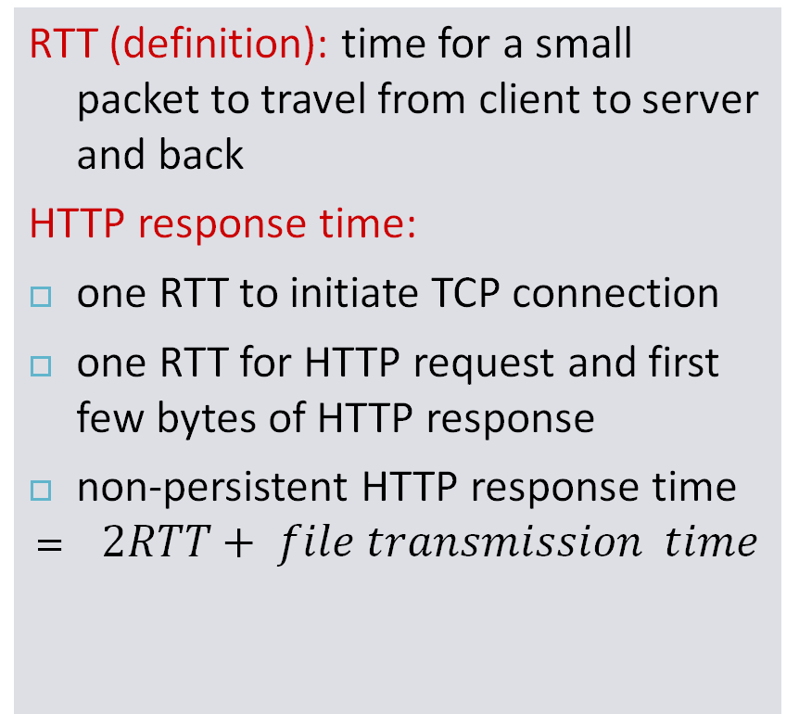
Non-persistent HTTP: response time
initiate TCP
connection
RTT
request
file
RTT
time to
transmit
file
file
received
time
time

Slide 23
Persistent HTTP
persistent HTTP:
server leaves connection open after sending response
subsequent HTTP messages between same client/server sent over open connection (pipelining)
client sends requests as soon as it encounters a referenced object
as little as one RTT for all the referenced objects
Typically, the HTTP server closes a connection when it isn’t used for a certain.
non-persistent HTTP issues:
requires 2 RTTs per object
OS overhead
For each connection, TCP buffers must be allocated and TCP variables must be kept in both the client and server.
browsers often open parallel TCP connections to fetch referenced objects

Slide 24
HTTP request message
two types of HTTP messages: request, response
HTTP request message:
ASCII (human-readable format)
carriage return character
request line
(GET, POST,
HEAD commands)
line-feed character
GET /index.html HTTP/1.1\r\n
Host: www-net.cs.umass.edu\r\n
User-Agent: Firefox/3.6.10\r\n
Accept: text/html,application/xhtml+xml\r\n
Accept-Language: en-us,en;q=0.5\r\n
Accept-Encoding: gzip,deflate\r\n
Accept-Charset: ISO-8859-1,utf-8;q=0.7\r\n
Keep-Alive: 115\r\n
Connection: keep-alive\r\n
\r\n
header
lines
carriage return,
line feed at start
of line indicates
end of header lines

Slide 25
HTTP request message: general format
method
sp
URL
sp
version
cr
lf
request
line
header field name
value
cr
lf
~
~
header
lines
~
~
header field name
value
cr
lf
cr
lf
~
entity body
~
body
~
~

Slide 26
Uploading form input
POST method:
web page often includes form input
input is uploaded to server in entity body
The entity body is empty with the GET method, but is used with the POST method.
URL method:
uses GET method
input is uploaded in URL field of request line:
www.somesite.com/animalsearch?monkeys&banana

Slide 27
Method types
HTTP/1.0:
GET
POST
HEAD
Similar to GET method
asks server to leave requested object out of response
May be used for debugging
HTTP/1.1:
GET, POST, HEAD
PUT
used by applications that need to upload objects to Web servers.
DELETE
deletes file specified in the URL field

Slide 28
HTTP response message
status line
(protocol
status code
status phrase)
HTTP/1.1 200 OK\r\n
Date: Sun, 26 Sep 2010 20:09:20 GMT\r\n
Server: Apache/2.0.52 (CentOS)\r\n
Last-Modified: Tue, 30 Oct 2007 17:00:02 GMT\r\n
ETag: "17dc6-a5c-bf716880"\r\n
Accept-Ranges: bytes\r\n
Content-Length: 2652\r\n
Keep-Alive: timeout=10, max=100\r\n
Connection: Keep-Alive\r\n
Content-Type: text/html; charset=ISO-8859-1\r\n
\r\n
data data data data data ...
header
lines
data, e.g.,
requested
HTML file

Slide 29
HTTP response status codes
status code appears in 1st line in server-to-client response message.
some sample codes:
200 OK
request succeeded, requested object later in this msg
301 Moved Permanently
requested object moved, new location specified later in this msg (Location:)
400 Bad Request
requested msg not understood by server
404 Not Found
requested document not found on this server
505 HTTP Version Not Supported

Slide 30
User-server state: cookies
many Web sites use cookies
four components:
1) cookie header line of HTTP response message
2) cookie header line in next HTTP request message
3) cookie file kept on user’s host, managed by user’s browser
4) back-end database at Web site
example:
visits specific e-commerce site for first time
when initial HTTP requests arrives at site, site creates:
unique ID
entry in backend database for ID

Slide 31
Cookies: keeping “state” (cont.)
client
server
ebay 8734
usual http request msg
Amazon server
creates ID
1678 for user
cookie file
usual http response
set-cookie: 1678
backend
database
create
entry
ebay 8734
amazon 1678
usual http request msg
cookie: 1678
cookie-
specific
action
access
usual http response msg
one week later:
access
ebay 8734
amazon 1678
usual http request msg
cookie: 1678
cookie-
specific
action
usual http response msg

Slide 32
Cookies (continued)
aside
what cookies can be used for:
authorization
shopping carts
recommendations
cookies and privacy:
cookies permit sites to learn a lot about you
you may supply name and e-mail to sites
how to keep “state”:
protocol endpoints: maintain state at sender/receiver over multiple transactions
cookies: http messages carry state

Slide 33

Web caches (proxy server)
goal: satisfy client request without involving origin server
user sets browser: Web accesses via cache
browser sends all HTTP requests to cache
object in cache: cache returns object
else cache requests object from origin server, then returns object to client
proxy
server
HTTP request
HTTP request
client
origin
server
HTTP response
HTTP response
HTTP request
HTTP response
client
origin
server

Slide 34
More about Web caching
why Web caching?
reduce response time for client request
reduce traffic on an institution’s access link
typically cache is installed by ISP (university, company, residential ISP)

Slide 35
Conditional GET
Goal: don’t send object if cache has up-to-date cached version
no object transmission delay
lower link utilization
cache: specify date of cached copy in HTTP request
If-modified-since: <date>
server: response contains no object if cached copy is up-to-date:
HTTP/1.0 304 Not Modified
client
server
HTTP request msg
If-modified-since: <date>
object
not
modified
HTTP response
HTTP/1.0
304 Not Modified
HTTP request msg
If-modified-since: <date>
object
modified
after
<date>
HTTP response
HTTP/1.0 200 OK
<data>

Slide 36
Chapter 2: outline
2.1 principles of network applications
2.2 Web and HTTP
2.3 FTP
2.4 Electronic mail
SMTP, POP3, IMAP
2.5 DNS

Slide 37
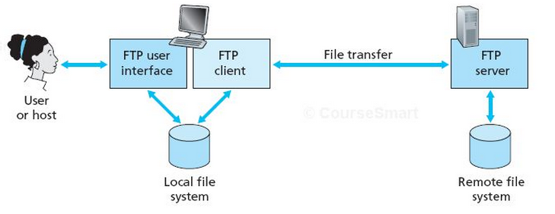
FTP: the file transfer protocol
transfer file to/from remote host
client/server model
client: side that initiates transfer (either to/from remote)
server: remote host
ftp server: port 21

Slide 38
FTP: separate control, data connections
TCP control connection,
server port 21
FTP client contacts FTP server at port 21, using TCP
Over control connection
client authorized
client browses remote directory, sends commands
when server receives file transfer command, server opens 2nd TCP data connection (for file) to client
after transferring one file, server closes data connection
FTP
client
TCP data connection,
server port 20
FTP
server
FTP is said to send its control information out-of- band
FTP server maintains “state”: current directory, earlier authentication
data connections are non-persistent
Notes:
Control information: identification, password, commands to change remote directory, and commands to “ put” and “ get” files.

Slide 39
FTP commands, responses
sample commands:
sent as ASCII text over control channel
USER username
PASS password
LIST return list of file in current directory
RETR filename retrieves (gets) file
STOR filename stores (puts) file onto remote host
sample return codes
status code and phrase (as in HTTP)
331 Username OK, password required
125 data connection already open; transfer starting
425 Can’t open data connection
452 Error writing file

Slide 40
Chapter 2: outline
2.1 principles of network applications
2.2 Web and HTTP
2.3 FTP
2.4 Electronic mail
SMTP, POP3, IMAP
2.5 DNS

Slide 41
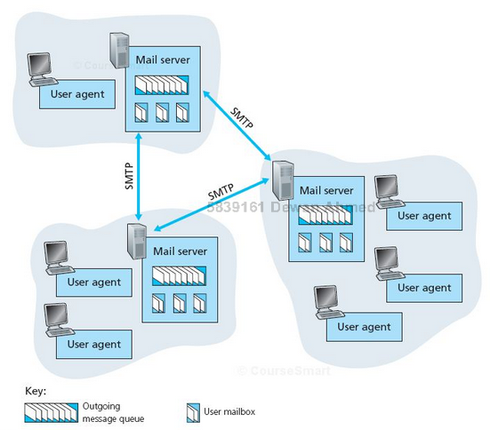
Electronic mail
Three major components:
user agents
mail servers
simple mail transfer protocol: SMTP
User Agent
a.k.a. “mail reader”
composing, editing, reading mail messages
e.g., Outlook, Thunderbird, iPhone mail client
Outgoing and incoming messages stored on server

Slide 42
Electronic mail: mail servers
mail servers:
mailbox contains incoming messages for user
message queue of outgoing (to be sent) mail messages
SMTP protocol between mail servers to send email messages

Slide 43
Electronic Mail: SMTP [RFC 2821]
uses TCP and port 25
Direct transfer: sending server to receiving server
Three phases of transfer
handshaking (greeting)
transfer of messages
closure
command/response interaction (like HTTP, FTP)
commands: ASCII text
response: status code and phrase
messages must be in 7-bit ASCII

Slide 44


Scenario: Alice sends message to Bob
1) Alice uses UA to compose message “to” bob@someschool.edu
2) Alice’s UA sends message to her mail server; message placed in message queue
3) client side of SMTP opens TCP connection with Bob’s mail server
4) SMTP client sends Alice’s message over the TCP connection
5) Bob’s mail server places the message in Bob’s mailbox
6) Bob invokes his user agent to read message
user
agent
mail
server
user
agent
1
mail
server
2
3
6
4
Alice’s mail server
5
Bob’s mail server

Slide 45
SMTP: final words
SMTP uses persistent connections
SMTP requires message (header & body) to be in 7-bit ASCII
SMTP server uses CRLF.CRLF to determine end of message
comparison with HTTP:
HTTP: pull
SMTP: push

Slide 46
Mail access protocols
user
agent
mail access
protocol
user
agent
SMTP
SMTP
(e.g., POP,
IMAP)
sender’s mail
server
receiver’s mail
server
SMTP: delivery/storage to receiver’s server
mail access protocol: retrieval from server
POP: Post Office Protocol [RFC 1939]: authorization, download
IMAP: Internet Mail Access Protocol [RFC 1730]: more features, including manipulation of stored msgs on server
HTTP: gmail, Hotmail, Yahoo! Mail, etc.

Slide 47
POP3 protocol
S: +OK POP3 server ready
C: user bob
S: +OK
C: pass hungry
S: +OK user successfully logged on
authorization phase
client commands:
user: declare username
pass: password
server responses
+OK
-ERR
transaction phase, client:
list: list message numbers
retr: retrieve message by number
dele: delete
quit
C: list
S: 1 498
S: 2 912
S: .
C: retr 1
S: <message 1 contents>
S: .
C: dele 1
C: retr 2
S: <message 1 contents>
S: .
C: dele 2
C: quit
S: +OK POP3 server signing off

Slide 48
POP3 (more) and IMAP
more about POP3
previous example uses POP3 “download and delete” mode
cannot re-read e-mail if you change client
POP3 “download-and-keep”: copies of messages on different clients
IMAP
keeps all messages in one place: at server
allows user to organize messages in folders
keeps user state across sessions:
names of folders and mappings between message IDs and folder name
Good for low-bandwidth connection
permit a user agent to obtain components of messages.

Slide 49
Chapter 2: outline
2.1 principles of network applications
2.2 Web and HTTP
2.3 FTP
2.4 Electronic mail
SMTP, POP3, IMAP
2.5 DNS

Slide 50
DNS: domain name system
Domain Name System:
distributed database implemented in hierarchy of many name servers
application-layer protocol: hosts and name servers communicate to resolve names (address/name translation)
Internet hosts and routers:
IP address (32 bit) - used for addressing datagrams
“name”, e.g., www.yahoo.com - used by humans
Q: how to map between IP address and name, and vice versa ?

Slide 51
DNS: services, structure
All DNS query and reply messages are sent within UDP datagrams to port 53.
DNS services
hostname to IP address translation
host aliasing
canonical, alias names
mail server aliasing
load distribution
replicated Web servers: many IP addresses correspond to one name
Notes:
A set of IP addresses associated with one canonical hostname.
The DNS database contains this set of IP addresses.
When clients make a DNS query for a name mapped to a set of addresses, the server responds with the entire set of IP addresses, but rotates the ordering of the addresses within each reply.
Because a client typically sends its HTTP request message to the IP address that is listed first in the set, DNS rotation distributes the traffic among the replicated

Slide 52
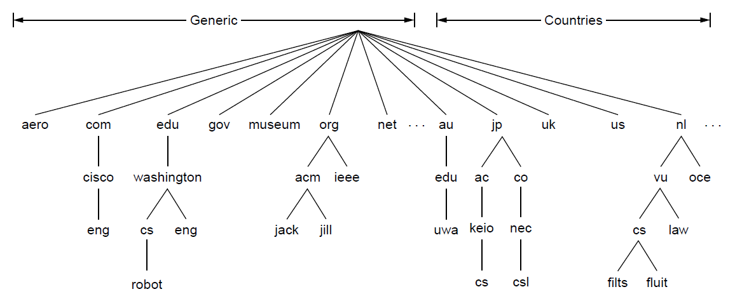
The DNS Name Space (1)
DNS namespace is hierarchical from the root down
Different parts delegated to different organizations
The computer robot.cs.washington.edu

Slide 53
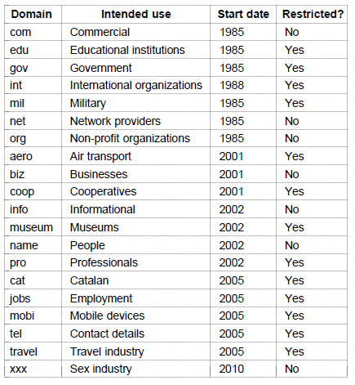
The DNS Name Space (2)
Generic top-level domains are controlled by ICANN (Internet Corporation for Assigned Names and Numbers) who appoints registrars to run them

Slide 54
DNS: a distributed, hierarchical database
Root DNS Servers
…
…
com DNS servers
org DNS servers
edu DNS servers
yahoo.com
DNS servers
pbs.org
DNS servers
poly.edu
DNS servers
umass.edu
DNS servers
amazon.com
DNS servers
client wants IP for www.amazon.com; 1st approx:
client queries root server to find com DNS server
client queries .com DNS server to get amazon.com DNS server
client queries amazon.com DNS server to get IP address for www.amazon.com

Slide 55
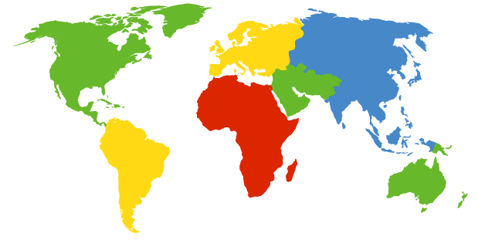
DNS: root name servers
contacted by local name server that can not resolve name
c. Cogent, Herndon, VA (5 other sites)
d. U Maryland College Park, MD
h. ARL Aberdeen, MD
j. Verisign, Dulles VA (69 other sites )
k. RIPE London (17 other sites)
i. Netnod, Stockholm (37 other sites)
e. NASA Mt View, CA
f. Internet Software C.
Palo Alto, CA (and 48 other sites)
m. WIDE Tokyo
(5 other sites)
13 root name “servers” worldwide
a. Verisign, Los Angeles CA
(5 other sites)
b. USC-ISI Marina del Rey, CA
l. ICANN Los Angeles, CA
(41 other sites)
g. US DoD Columbus, OH (5 other sites)

Slide 56
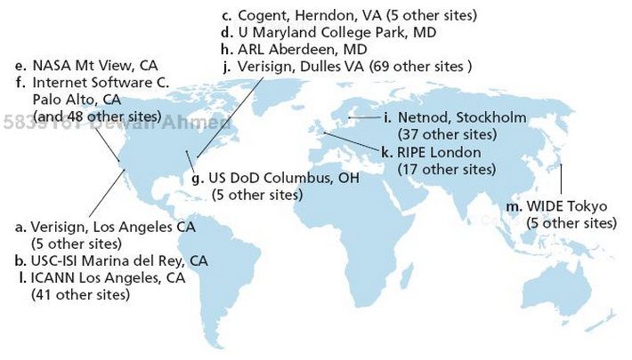
DNS: root name servers
Each “ root server” is actually a network of replicated servers, for both security and reliability purposes.
All together, there are 247 root servers as of fall 2011. [504 as of 17 January 2016]

Slide 57
TLD and authoritative servers
top-level domain (TLD) servers:
responsible for com, org, net, edu, aero, jobs, museums, and all top-level country domains, e.g.: uk, fr, ca, jp
Network Solutions maintains servers for .com TLD
Educause for .edu TLD
authoritative DNS servers:
organization’s own DNS server(s), providing authoritative hostname to IP mappings for organization’s named hosts
can be maintained by organization or service provider

Slide 58
Local DNS name server
does not strictly belong to hierarchy
each ISP (residential ISP, company, university) has one default name server
when host makes DNS query, query is sent to its local DNS server
has local cache of recent name-to-address translation pairs (but may be out of date!)
acts as proxy, forwards query into hierarchy

Slide 59
DNS name resolution example
root DNS server
host at cis.poly.edu wants IP address for gaia.cs.umass.edu
2
3
TLD DNS server
4
Iterated query:
contacted server replies with name of server to contact
“I don’t know this name, but ask this server”
5
local DNS server
dns.poly.edu
7
6
1
8
authoritative DNS server
dns.cs.umass.edu
requesting host
cis.poly.edu
gaia.cs.umass.edu

Slide 60
DNS name resolution example
root DNS server
Recursive query:
puts burden of name resolution on contacted name server
heavy load at upper levels of hierarchy?
2
3
7
6
TLD DNS
server
local DNS server
dns.poly.edu
5
4
1
8
authoritative DNS server
dns.cs.umass.edu
requesting host
cis.poly.edu
gaia.cs.umass.edu

Slide 61
DNS: caching, updating records
once (any) name server learns mapping, it caches mapping
cache entries timeout (disappear) after some time (TTL)
TLD servers typically cached in local name servers
thus root name servers not often visited
cached entries may be out-of-date (best effort name-to-address translation!)
if name host changes IP address, may not be known Internet-wide until all TTLs expire
update/notify mechanisms proposed IETF standard
RFC 2136

Slide 62
DNS records
DNS: distributed db storing resource records (RR)
RR format: (name, value, type, ttl)
type=A
name is hostname
value is IP address
( relay1.bar.foo.com, 145.37.93.126, A)
type=NS
name is domain (e.g., foo.com)
value is hostname of authoritative name server for this domain
( foo.com, dns.foo.com, NS)

Slide 63
DNS records
DNS: distributed db storing resource records (RR)
RR format: (name, value, type, ttl)
type=CNAME
name is alias name for some “canonical” (the real) name
www.ibm.com is really
servereast.backup2.ibm.com
value is canonical name
( foo.com, relay1.bar.foo.com, CNAME)
type=MX
value is name of mailserver associated with name
( foo.com, mail.bar.foo.com, MX)

Slide 64
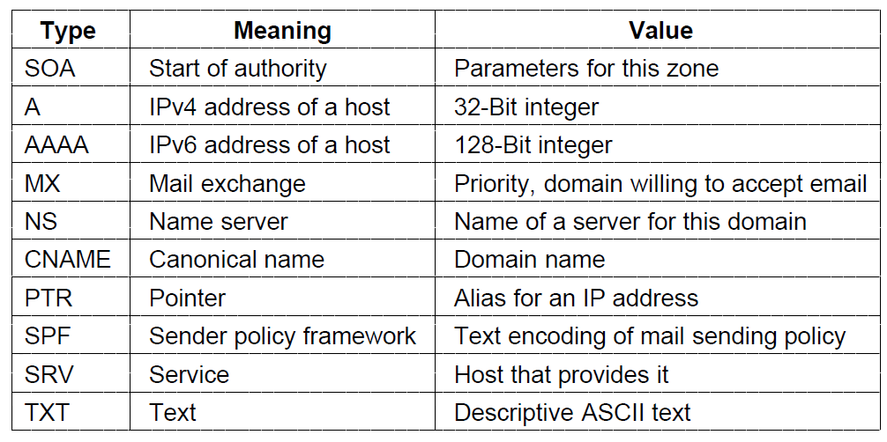
Domain Resource Records (1)
The key resource records in the namespace are IP addresses (A/AAAA) and name servers (NS), but there are others too (e.g., MX)

Slide 65
Inserting records into DNS
Example: new startup “Network Utopia”
register name networkutopia.com at DNS registrar (e.g., Network Solutions)
provide names, IP addresses of authoritative name server (primary and secondary)
registrar inserts two RRs into .com TLD server: (networkutopia.com, dns1.networkutopia.com, NS)
(dns1.networkutopia.com, 212.212.212.1, A)
Notes:
create authoritative server type A record for www.networkuptopia.com; type MX record for networkutopia.com

Slide 66
Thank you!

